Slide 1

Generative Artificial Intelligence and Well Engineering
Mapping the Capability Frontier and Quantifying Value
Vitor (PhD) and Claudio (Post-Doctoral), Petrobras
Presentation for Professor Antorweep and University of Stavanger (UiS)

Slide 2

Petrobras: Global Leadership in Deep Waters
Strategic Context
Petrobras is a world leader in deepwater exploration and production, operating in extreme environments up to 3,000 meters deep. Our excellence results from decades of experience and investment in technology.
Challenges in Well Construction
Management of millions of dispersed technical documents
Quick access to standards, lessons learned, and operational data
Risk of losing tacit knowledge from senior specialists
Need for critical decisions in minutes, not days
Generative AI as a Solution
Cortex: an AI platform developed with PUC-Rio, UNESP, Infotec, and Atos. It combines RAG (Retrieval-Augmented Generation) with state-of-the-art LLMs to transform corporate data into actionable knowledge, with traceable responses and multi-domain support.

Slide 3
Project Claudio: Quantifying the Value of the Cortex Copilot
01
02
The Problem
Objective and Methodology
Critical gap in literature: lack of rigorous empirical evidence on the real benefits of AI copilots in critical industrial environments. Executives and regulators demand quantification of time saved, improvement in decision quality, and impact on operational safety.
Comparative Study of Results in a real production environment. Comparison between a treatment group (well construction contracting, intensive use) and a control group (other areas, less frequent use).
03
04
Metrics and Data Collection
Importance and Impact
Time saved in information retrieval
Rigorous field evidence allows scaling AI with confidence. Understanding success mechanisms guides platform optimization. Identification of risks allows for the implementation of appropriate safeguards and governance.
Decision quality (blind evaluation by experts)
Operational safety (compliance and alerts)
Trustworthiness and traceability of responses
Data collected via system logs, structured surveys, qualitative interviews, and process indicators.

Slide 4

Project Vitor: Mapping the Irregular Frontier of Autonomous Agents
The Challenge
No one has mapped the Jagged Frontier for autonomous agents in high-complexity and high-risk domains. Petrobras needs to know: which tasks are safe to automate?
Experimental Methodology (4 Phases)
Task Taxonomy: 50-100 representative tasks classified by type, domain, and complexity
Experimental Benchmark: Sandbox with simulated tools and ground truth validated by specialists
Execution: Testing different architectures (pure LLM, RAG, ReAct) measuring success, quality, efficiency, and robustness
Analysis: Correlation between task characteristics and performance, root-cause analysis of failures
Expected Outcome
The Jagged Frontier
Decision framework for the safe transition from copilots to autonomous agents, identifying which tasks are in the peaks (safe automation) or valleys (necessary supervision) of the Jagged Frontier.
Concept by Brynjolfsson and Mollick (BCG/Wharton, 2023): AI performance is highly irregular, alternating between peaks of superhuman competence and valleys of unexpected failure.

Slide 5




Synergy: From Copilot to Autonomous Agent
Claudio Project (Postdoctoral)
Strategic Complementarity
Focus
Value Quantification
Technology
Copilot (Human Assistance)
Domain
Cortex in Production
Central Question
"What does the Copilot deliver?"
Vitor Project (Doctorate)
Focus
Capacity Mapping
Technology
Autonomous Agent (Automation)
Claudio validates current value
Domain
Rigorous field evidence demonstrates that Cortex works in production, identifying success mechanisms
Experimental Benchmark (Sandbox)
Vitor defines the future limit
Central Question
Jagged Frontier mapping identifies where agents fail and enables safe transition to automation
"Where does the Agent fail?"
Both focus on safety
LLM/RAG in Well Engineering with operational safety as a central concern
Integrated Narrative: Today, Cortex amplifies expertise (copilot). Tomorrow, safe automation of specific tasks (agent). A clear trajectory with scientific evidence at each step.

Slide 6


Collaboration Proposal: Leveraging UiS Expertise
How UiS Can Contribute
Mutual Benefits
Domain Validation
Well Engineering expertise to validate Vitor's Task Taxonomy: representative tasks, complete categories, adequate success criteria.
Access to Data and Cases
O&G operations data from Norway (Equinor, other operators) allow expanding scope and comparing Brazil vs. Norway contexts, increasing results generalization.
Methodological Review
Blind experts to evaluate agent responses (ground truth). Experimental methodology review ensuring alignment with best scientific standards.
Joint Publications
Co-authorship in high-impact journals and conferences (NeurIPS, ICML, IEEE, OTC, SPE). Petrobras-UiS publications gain greater credibility and visibility.
For Petrobras
Rigorous academic validation of projects
Access to UiS's global O&G expertise
High-impact publications reinforcing position as an innovator
Expansion of studies to international contexts
For UiS
Access to real industrial data from a world-leading operator
Applied research in AI and Well Engineering
Visibility in O&G innovation and Generative AI
Generation of insights that benefit the entire industry
Enduring Strategic Partnership: Advancement of scientific knowledge in Generative AI applied to critical domains, contributing to the digital transformation of the O&G industry.

Slide 7
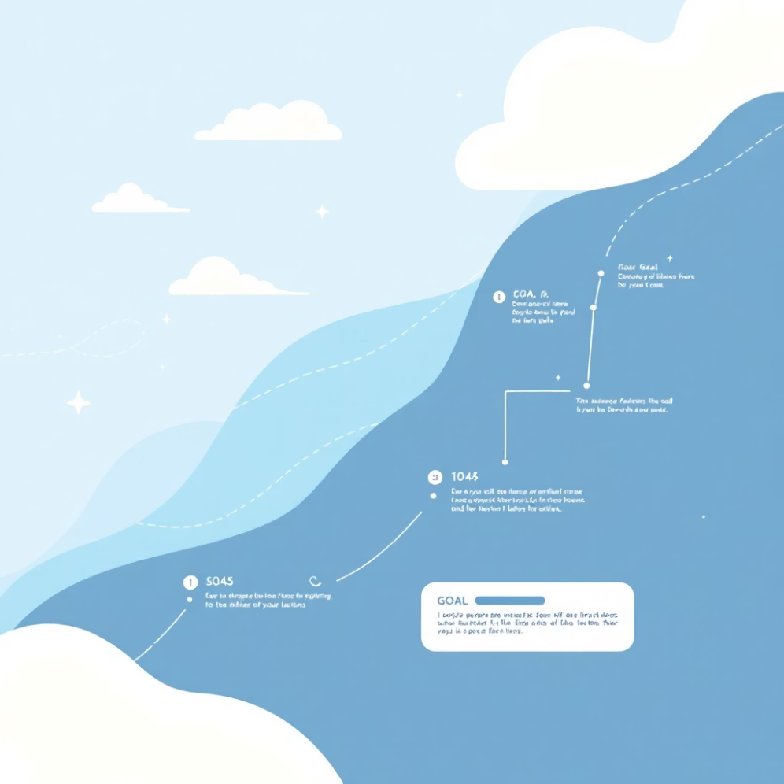
Next Steps and Call to Action
Proposal Summary
How to Formalize the Collaboration?
1
Cutting-Edge Research
Follow-up Meeting
Generative AI applied to a critical and high-impact domain: Well Engineering in O&G
Detail areas of contribution, data restrictions and confidentiality, relationship structuring
2
Complementary Projects
Claudio quantifies value (copilot in production). Vitor maps limits and risks (autonomous agent). Complete vision of technological evolution.
Co-Supervision of Researchers
UiS co-supervisors for monitoring, feedback, and alignment with best scientific standards
3
Focus on Safety
Data and Expertise Exchange
Traceability and operational effectiveness ensure academically relevant and immediately applicable results in the industry.
Data sharing protocol (confidentiality respected) and researcher exchange plan
Co-Authorship in Publications
Definition of co-authorship criteria from the outset, ensuring UiS recognition
Formal Agreement (MOU)
Memorandum of Understanding formalizing partnership, terms, responsibilities, and benefits
Timeline
Perfect Timing: Vitor (1st year PhD) and Claudio (start of post-doc) are at an ideal stage to incorporate collaboration from the beginning.
Preliminary results: 12-18 months | Publications: 24-30 months

Slide 8


Thank You
Contact Information
Strategic Opportunity
Vitor - PhD Candidate, Petrobras
Mutually beneficial collaboration between Petrobras and the University of Stavanger to address critical challenges in the O&G industry.
Email: vitor.email@petrobras.com.br
Phone/WhatsApp: +55 XX XXXXX-XXXX
Claudio - Postdoctoral Researcher, Petrobras
Challenges we face together: How to safely apply Generative AI in critical domains? How to quantify real value? How to safely transition to automation?
Email: claudio.email@petrobras.com.br
Phone/WhatsApp: +55 XX XXXXX-XXXX
We are open to discussions, virtual meetings, or visits to discuss this collaboration in more detail.
Special Thanks
Professor Antorweep and representatives of the University of Stavanger, we sincerely thank you for the opportunity to present our collaboration proposal.

Slide 9


Questions and Discussion
Questions about the Projects
Methodology, scope, timeline, or applicability of Claudio's and Vitor's projects
Suggestions for Collaboration
How can UiS contribute more effectively? Additional areas of interest?
Feasibility and Methodology
Concerns about implementation, data confidentiality, or scientific alignment
Vitor and Claudio are available to answer all your questions and discuss next steps to establish this strategic partnership.
Invitation: This is an opportunity for collaboration that can generate transformative insights for the O&G industry. Let's work together to advance knowledge in Generative AI applied to critical domains.

